Slide 1
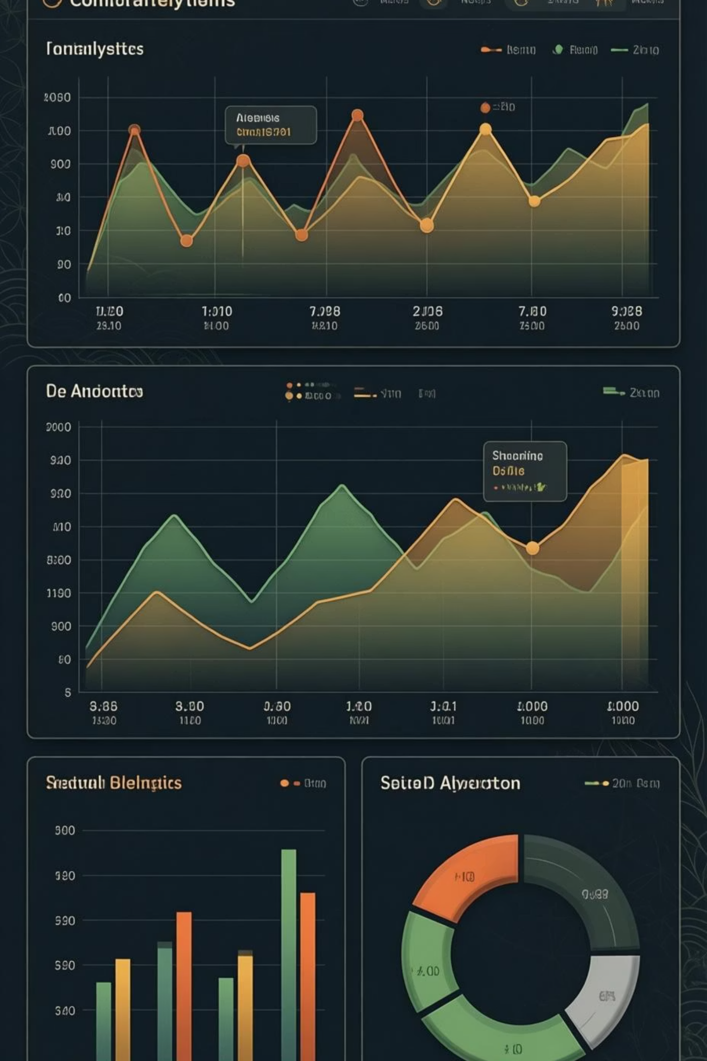
Customer Shopping Behavior Analysis
Uncovering insights from 3,900 purchases to guide strategic business decisions

Slide 2

OVERVIEW
Dataset at a Glance
3,900
18
$59.76
3.75
Total Purchases
Data Points
Avg Purchase
Avg Rating
Transactions analyzed across all categories
Features tracked per customer
Mean transaction value
Customer satisfaction score

Slide 3

DATA PREPARATION
Python Analysis Pipeline
01
Data Loading & Exploration
Imported dataset, checked structure with pandas
02
Missing Data Handling
Imputed 37 missing review ratings using category medians
03
Feature Engineering
Created age groups and purchase frequency metrics
04
Database Integration
Loaded cleaned data into PostgreSQL for SQL analysis

Slide 4
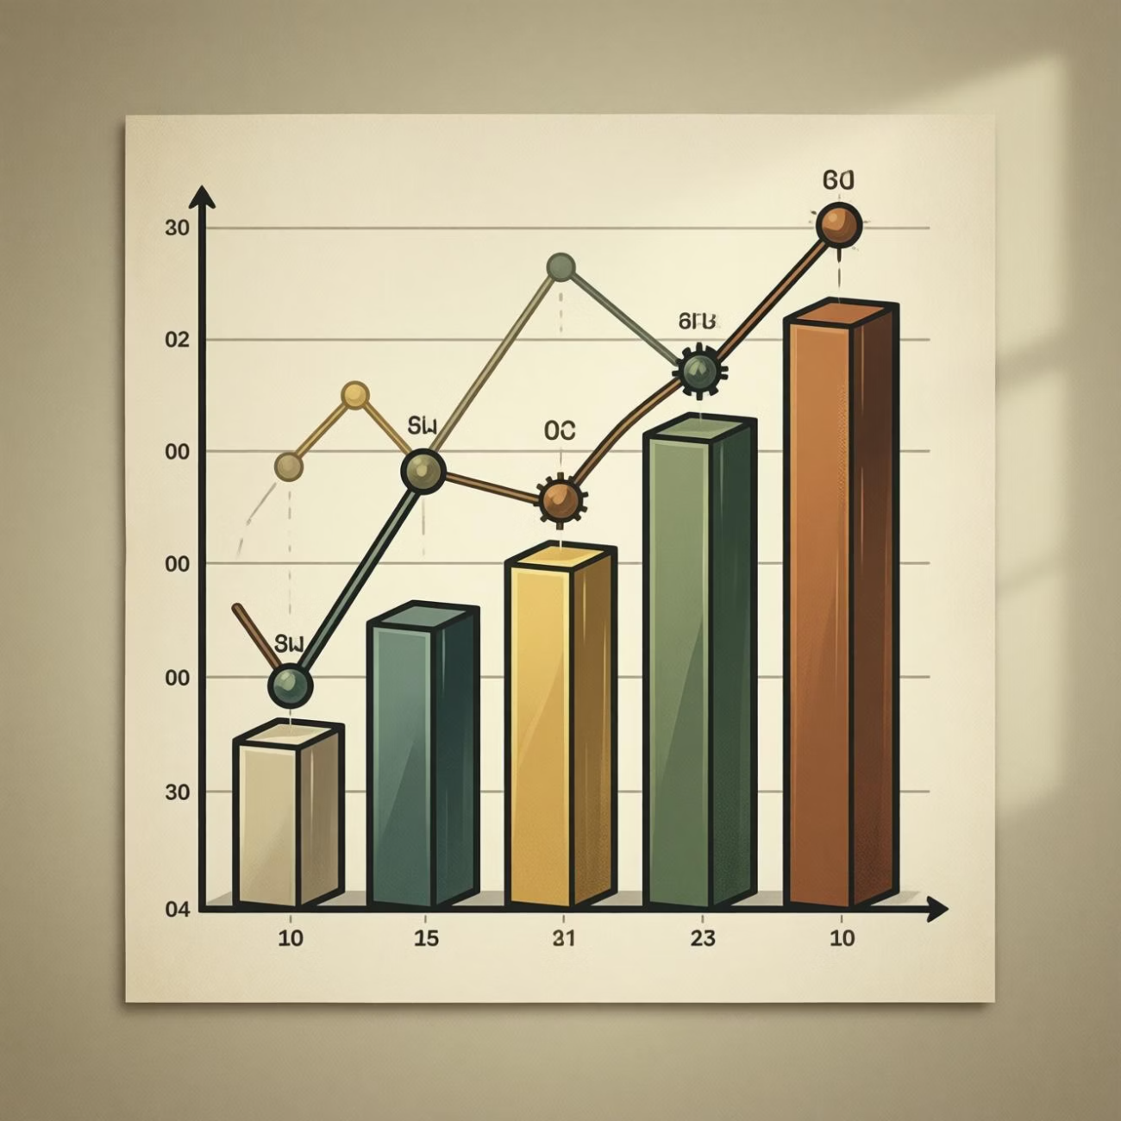
REVENUE INSIGHTS
Gender & Spending Patterns
Male Customers
$157,890 total revenue
68% of total sales
Female Customers
$75,191 total revenue
32% of total sales
Male customers drive majority of revenue despite representing 68% of customer base

Slide 5
Product Performance Leaders
1
2
3
Gloves
Sandals
Boots
Rating: 3.86
Rating: 3.84
Rating: 3.82
Top-rated product across all categories
Strong customer satisfaction in footwear
Consistent high ratings
4
5
Hat
Skirt
Rating: 3.80
Rating: 3.78
Popular accessory choice
Strong clothing category performer

Slide 6




CUSTOMER SEGMENTS
Loyalty Distribution
Returning
701 customers
18% showing repeat behavior
Loyal Customers
3,116 customers
80% of customer base
New Customers
83 customers
2% first-time buyers

Slide 7


Subscription Impact Analysis
Subscribers
Avg spend: $59.49
27%
Total: $62,645
Non-Subscribers
Avg spend: $59.87
Subscribers
Total: $170,436
1,053 customers enrolled
73%
Non-Subscribers
2,847 customers
Minimal spending difference suggests opportunity to enhance subscription value proposition

Slide 8
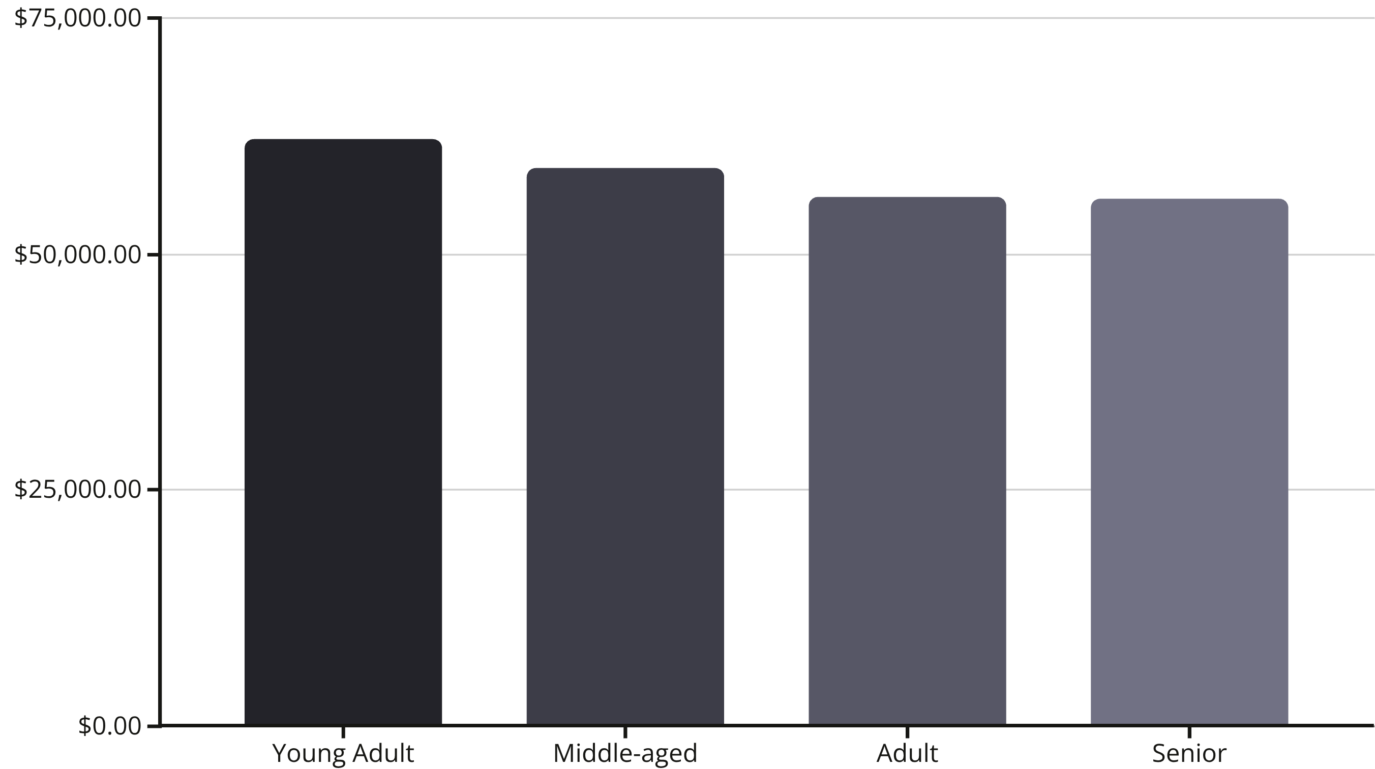
REVENUE BREAKDOWN
Age Group Performance
Young adults lead revenue generation, followed closely by middle-aged customers

Slide 9

DISCOUNT STRATEGY
High-Value Discount Users
Smart Spenders
839 customers used discounts but spent above average
Top Discount Products
Hat: 50% discount rate
Sneakers: 49.66%
Coat: 49.07%
Discounts drive volume without sacrificing transaction value

Slide 10





ACTION PLAN
Strategic Recommendations
Boost Subscriptions
Promote exclusive benefits to convert 73% non-subscribers
Loyalty Programs
Reward repeat buyers to strengthen 80% loyal base
Targeted Marketing
Focus on young adults and express-shipping users
Product Positioning
Highlight top-rated items in campaigns

